Slide 1

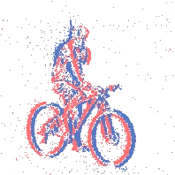
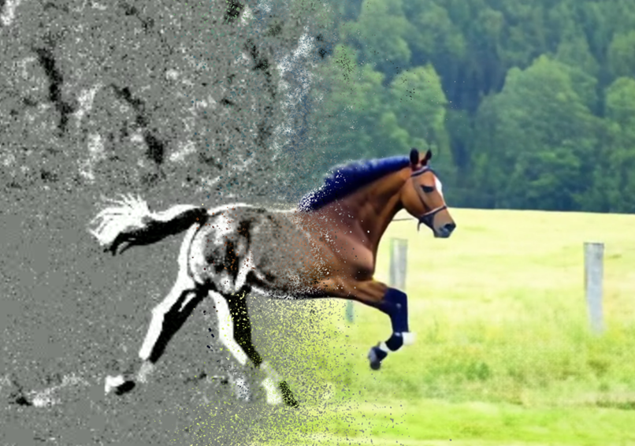
EVGEN
EVGEN
Event-based Vision in the Era of Generative AI
Event-based Vision in the Era of Generative AI

